Slide 1
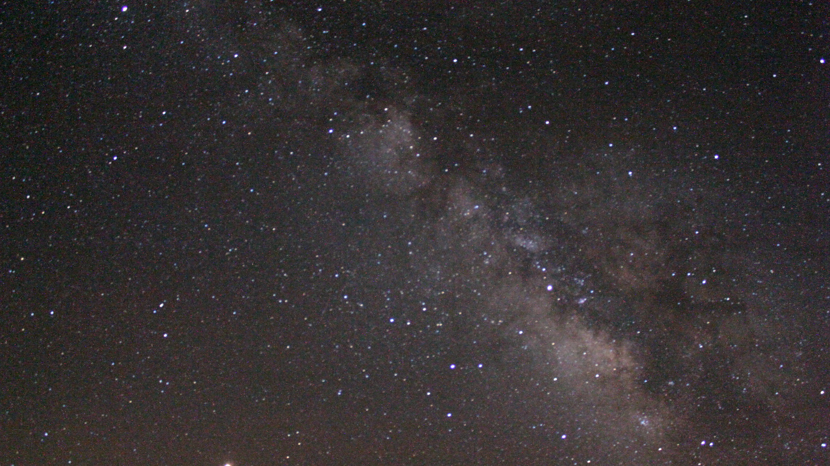
Week 1: Intro Week & Meet the Team!
Fantastic series of lectures from researchers, scientists, & SMEs in Astronomy, Astrophysics, & SETI
Breakthrough Listen background and capabilities
Science areas and active areas of research
Data, software tools, datacenter access, etc.
Readings & research into project statements
Meeting and learning more about team member backgrounds

Slide 2

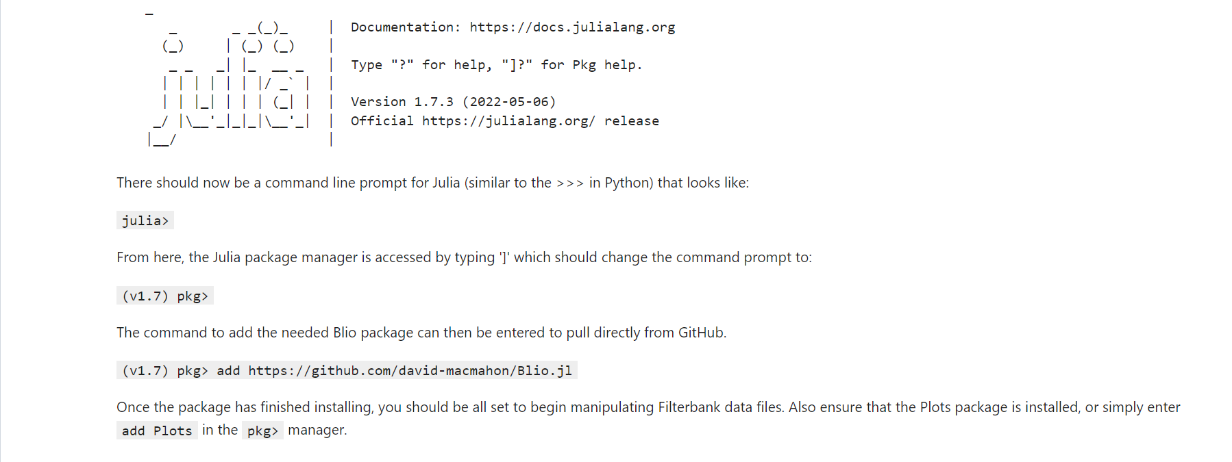
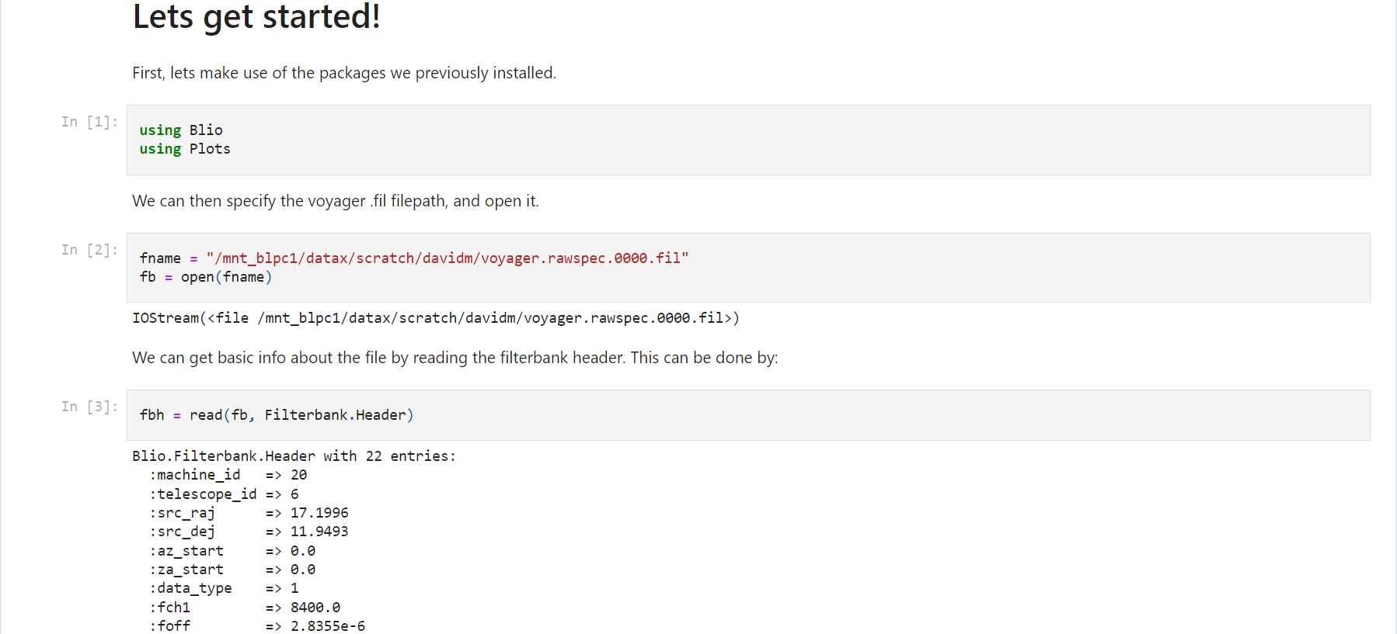
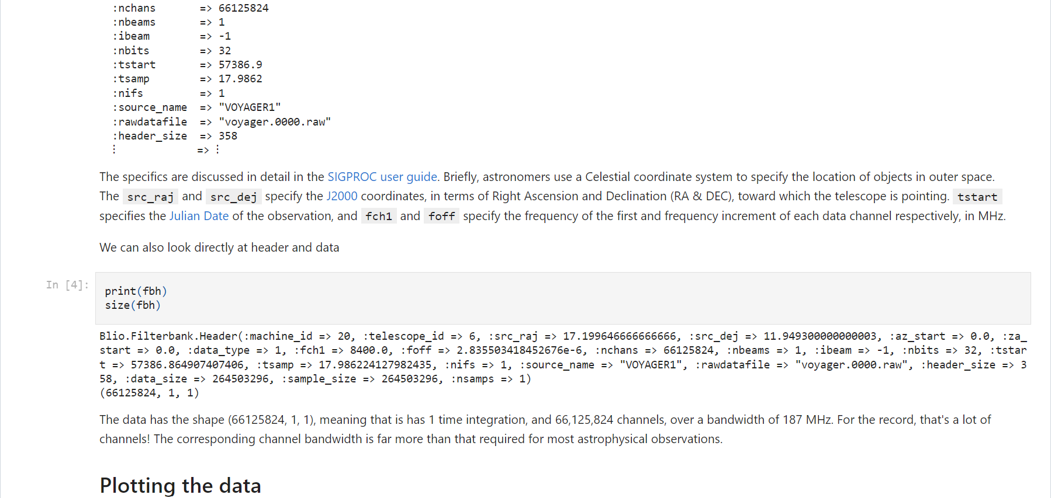
Week 2: Julia Hands-On & Voyager 1 Notebook
Julia experience needed!
Tutorials
Reading Documentation
Hands-on practice
Voyager 1 Jupyter Notebook
Public facing demo of how to interact with BL data
Translation from Python to Julia to demo
Access, logins, etc.
Pushing work to GitHub

Slide 3
Week 3: Understanding the Algorithms & More Julia Practice
Algorithms
Julia
Parallel / CUDA / GPU reading of documentation & practice
Dedispersion
Accounts for dispersive nature of signals crossing interstellar medium
Applicable to transient astronomy
Used to identify quadratic (higher order) curves in observation data
Greater existing R&D base as more broad astronomy applicability
Multiple algorithmic implementations
Brute force
Taylor Tree
Fast Dispersion Measure Transform (FDMT)
Fourier-Domain Dedispersion
CPU and GPU implementations
No full SETI pipelines, more pure algorithm base
Dedoppler
Accounts for doppler drift in signals
Mostly relevant for SETI signal searches
Used to identify linear curves (lines) in observation data
More limited R&D base as more niche research focus
Existing SETI pipelines (includes I/O, preprocessing, dedoppler, & hit search)
turboSETI (CPU & GPU)
SETIcore
hyperSETI
Numerically very similar to dedispersion
Flip frequency and time axes
Linear vs quadratic curve to search for

Slide 4
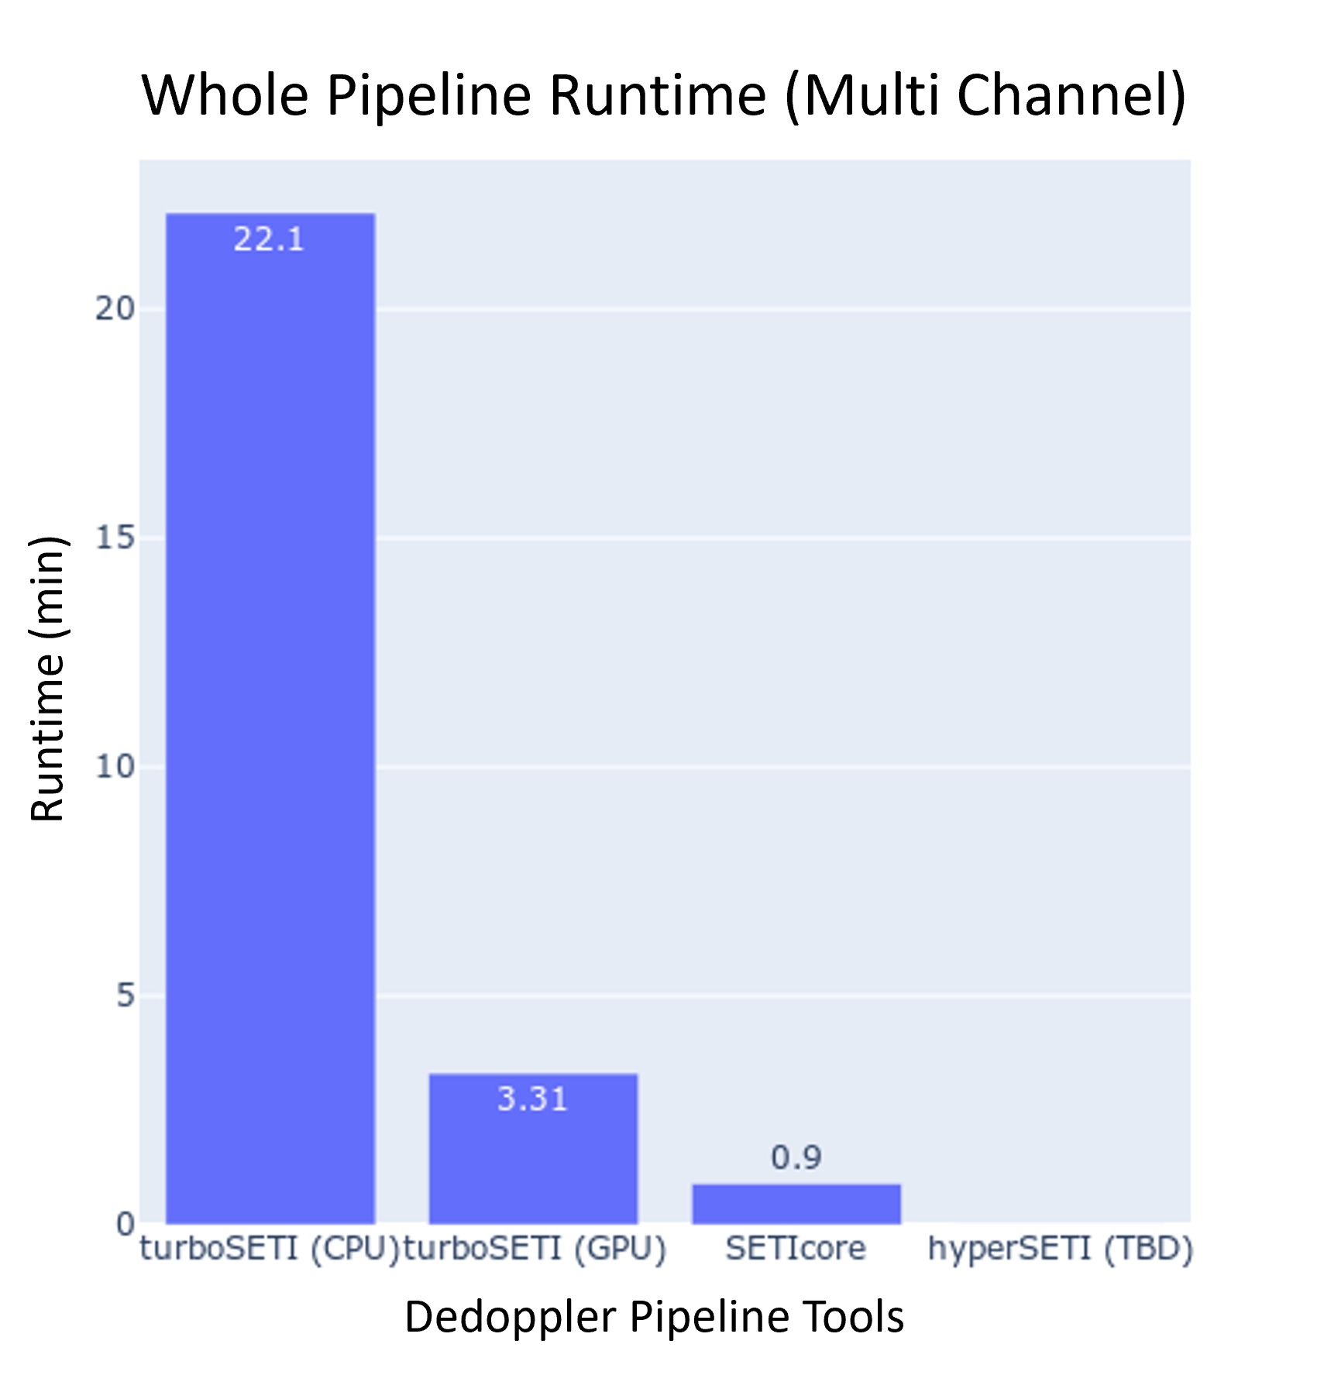
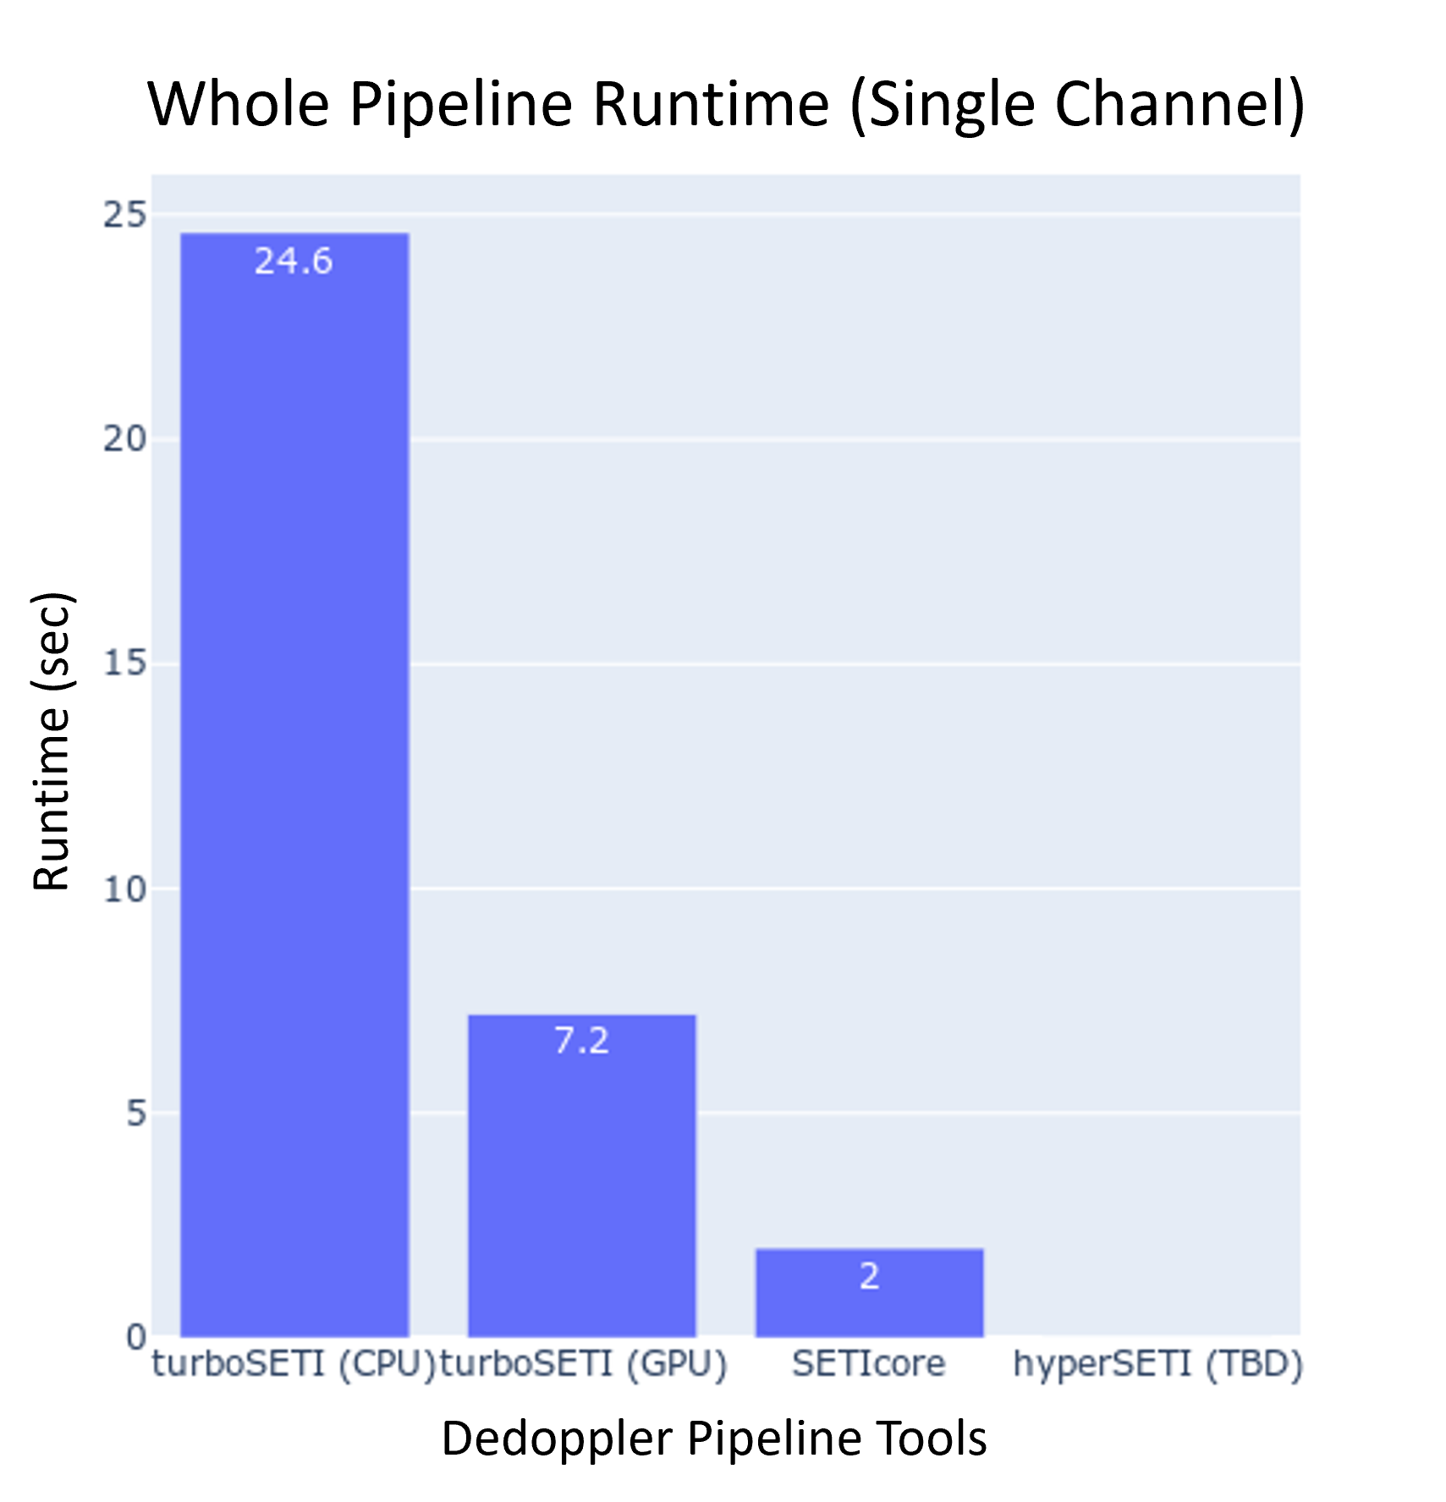
Week 4: Analysis of Existing Tools: Performance
Dedoppler
Pipeline vs algorithm
Dedispersion tools are algorithms
Dedoppler tools are usually used in whole pipeline including the I/O, data processing, & hit search
Makes benchmarking more subjective
Consider algorithm only or standard user process?
Some algorithm only benchmarking done [Max]
Whole pipeline analysis performed
Full, multi-channel & single coarse channel .h5 files analyzed
Issues with hyperSETI to be resolved…

Slide 5
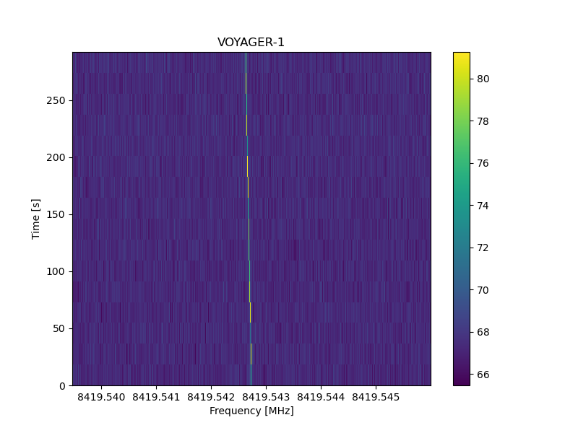
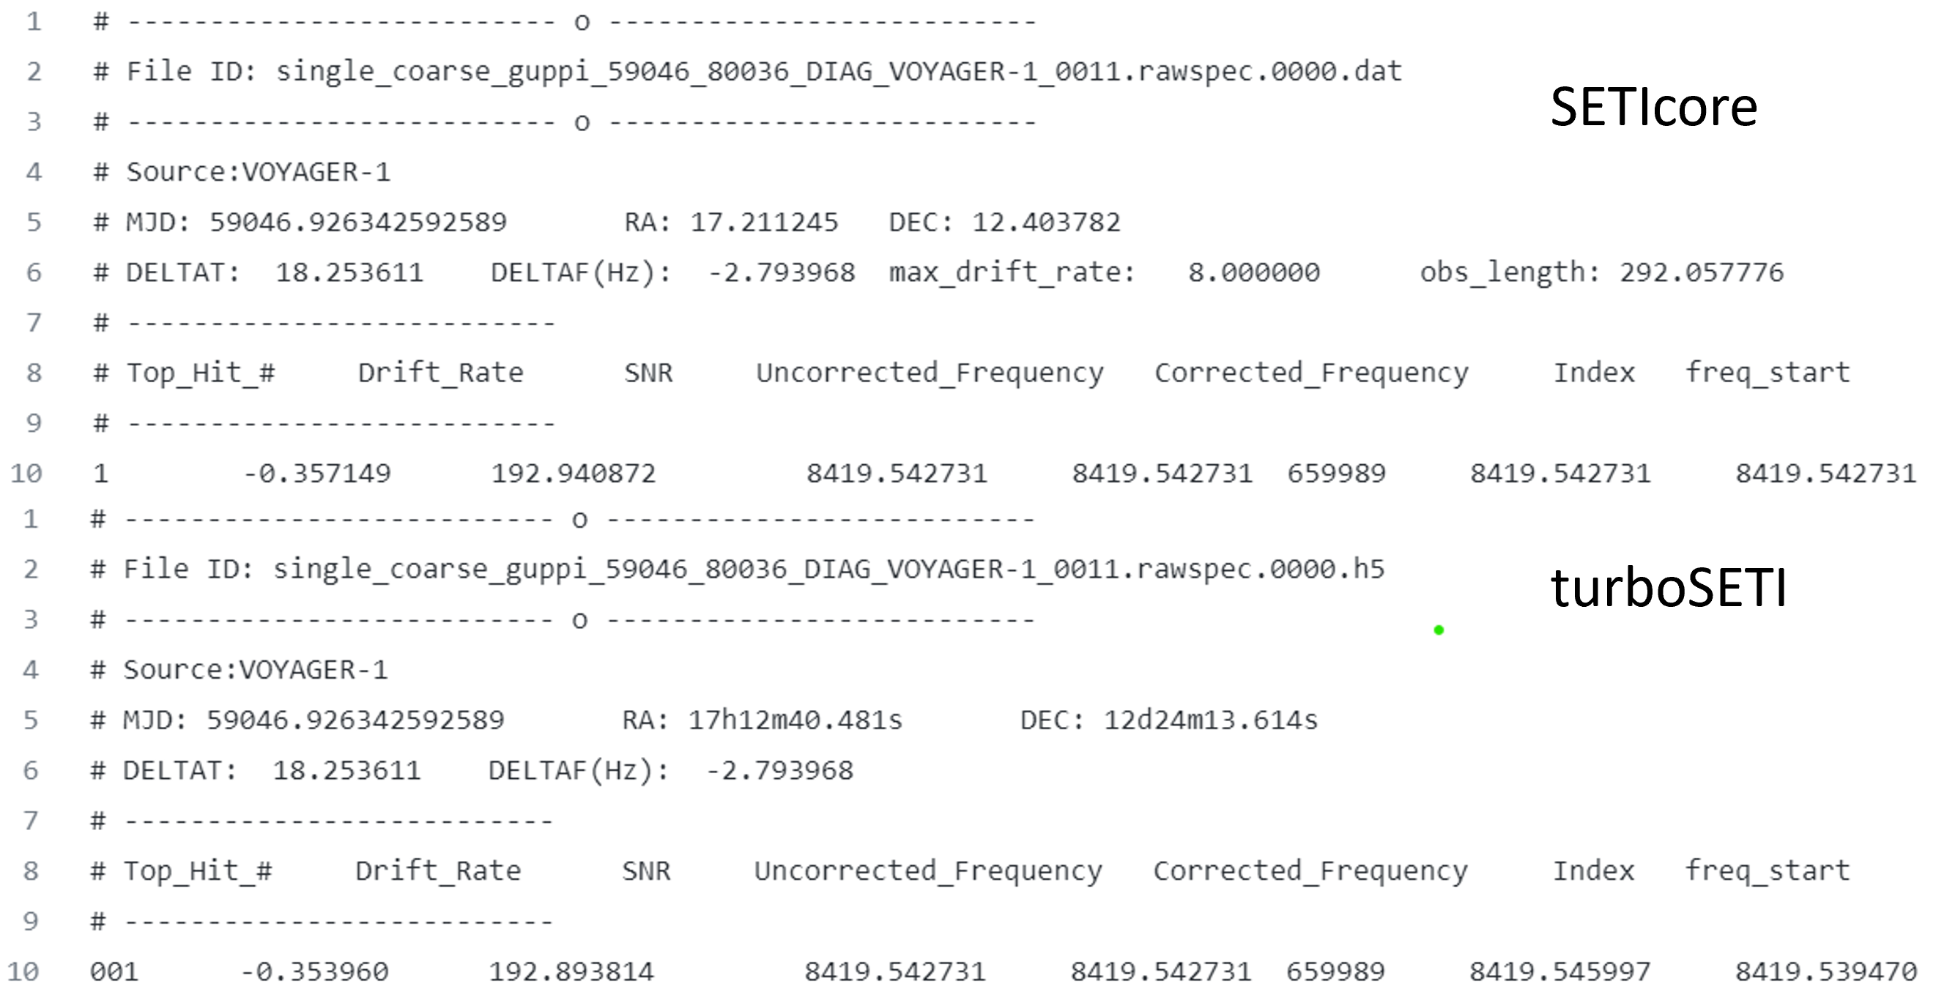
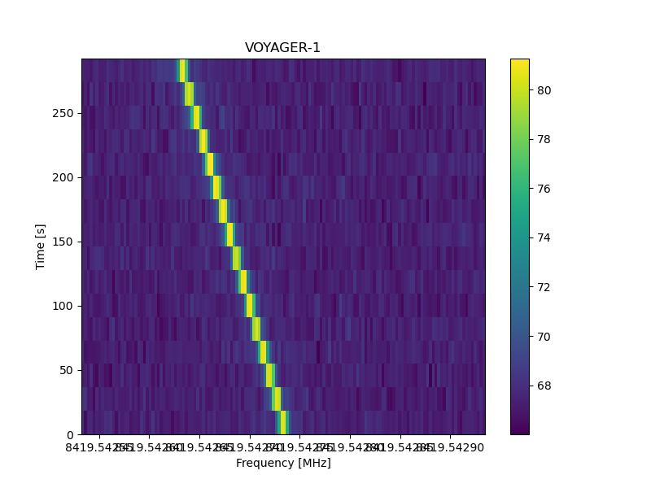
Week 4: Analysis of Existing Tools: Output
.dat Files & Hits (turboSETI vs SETIcore)
Similar but not identical
SETIcore
Hit found in .dat file includes only the center frequency (plot generated by including +/- 200 Hz)
turboSETI
Hit found in .dat file includes frequency range for plotting
SNR functionally equivalent
Corrected_Frequency exactly equal
Start/End Frequency range different

Slide 6
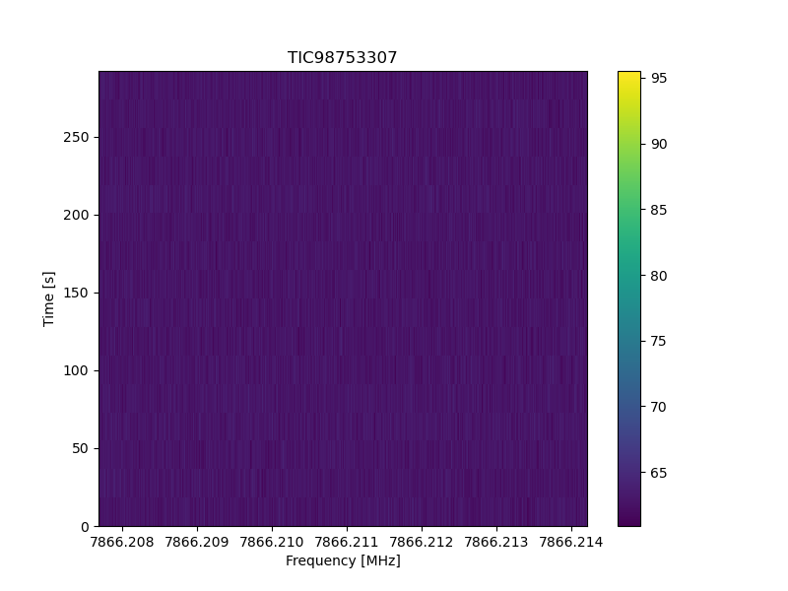
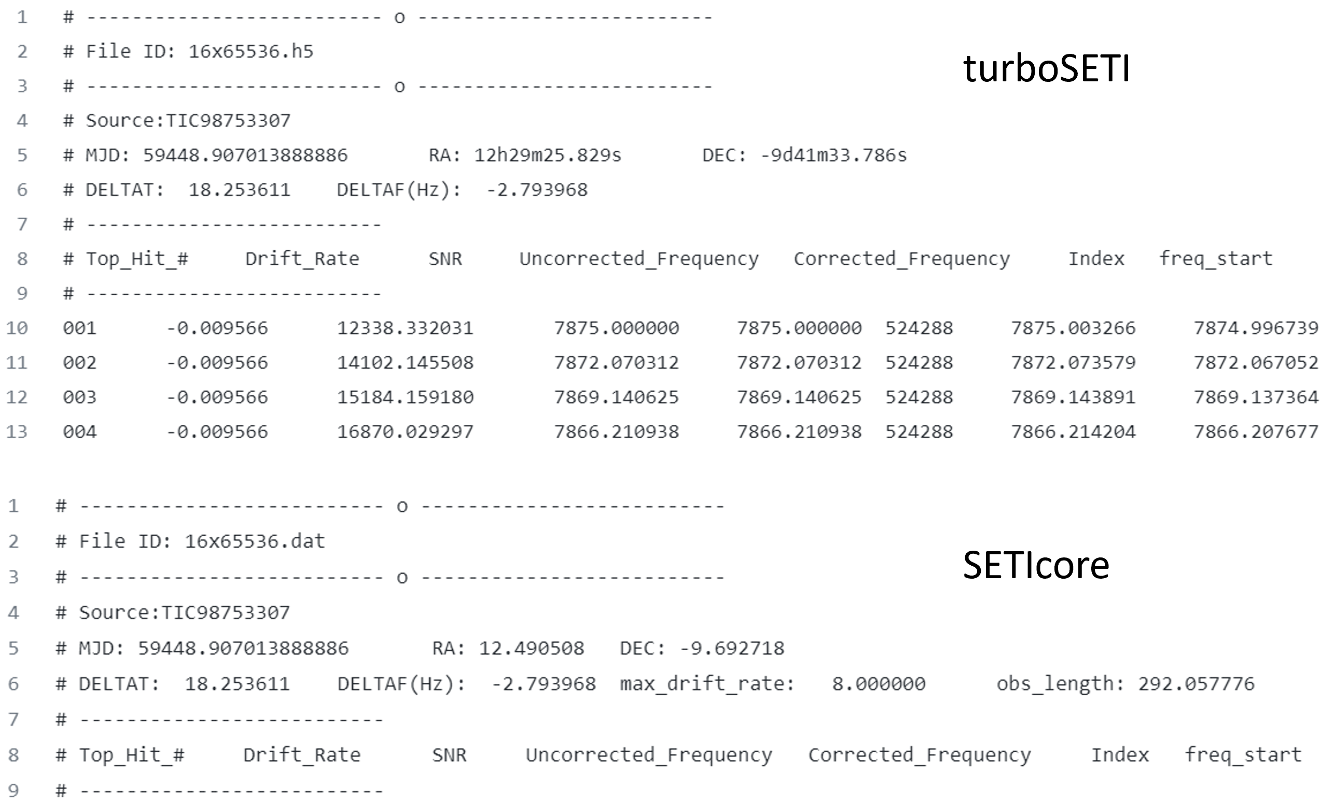
Week 4: Analysis of Existing Tools: Output
.dat Files & Hits (turboSETI vs SETIcore)
Similar but not identical
turboSETI plot is empty!
Maybe overly sensitive hit search compared to SETIcore
SETI core shows no hits in this .h5 file
No max SNR, maybe there should be?
~16870 SNR seems excessive…
turboSETI had many hits, though all have very high SNR
SETIcore had no hits

Slide 7
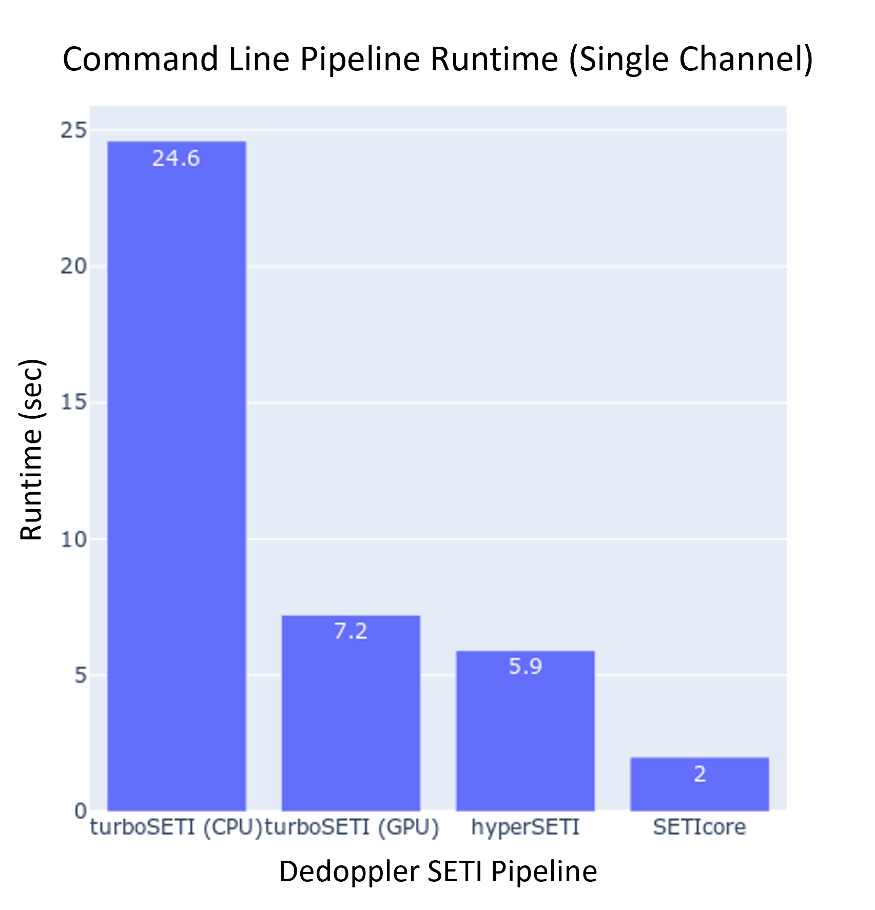
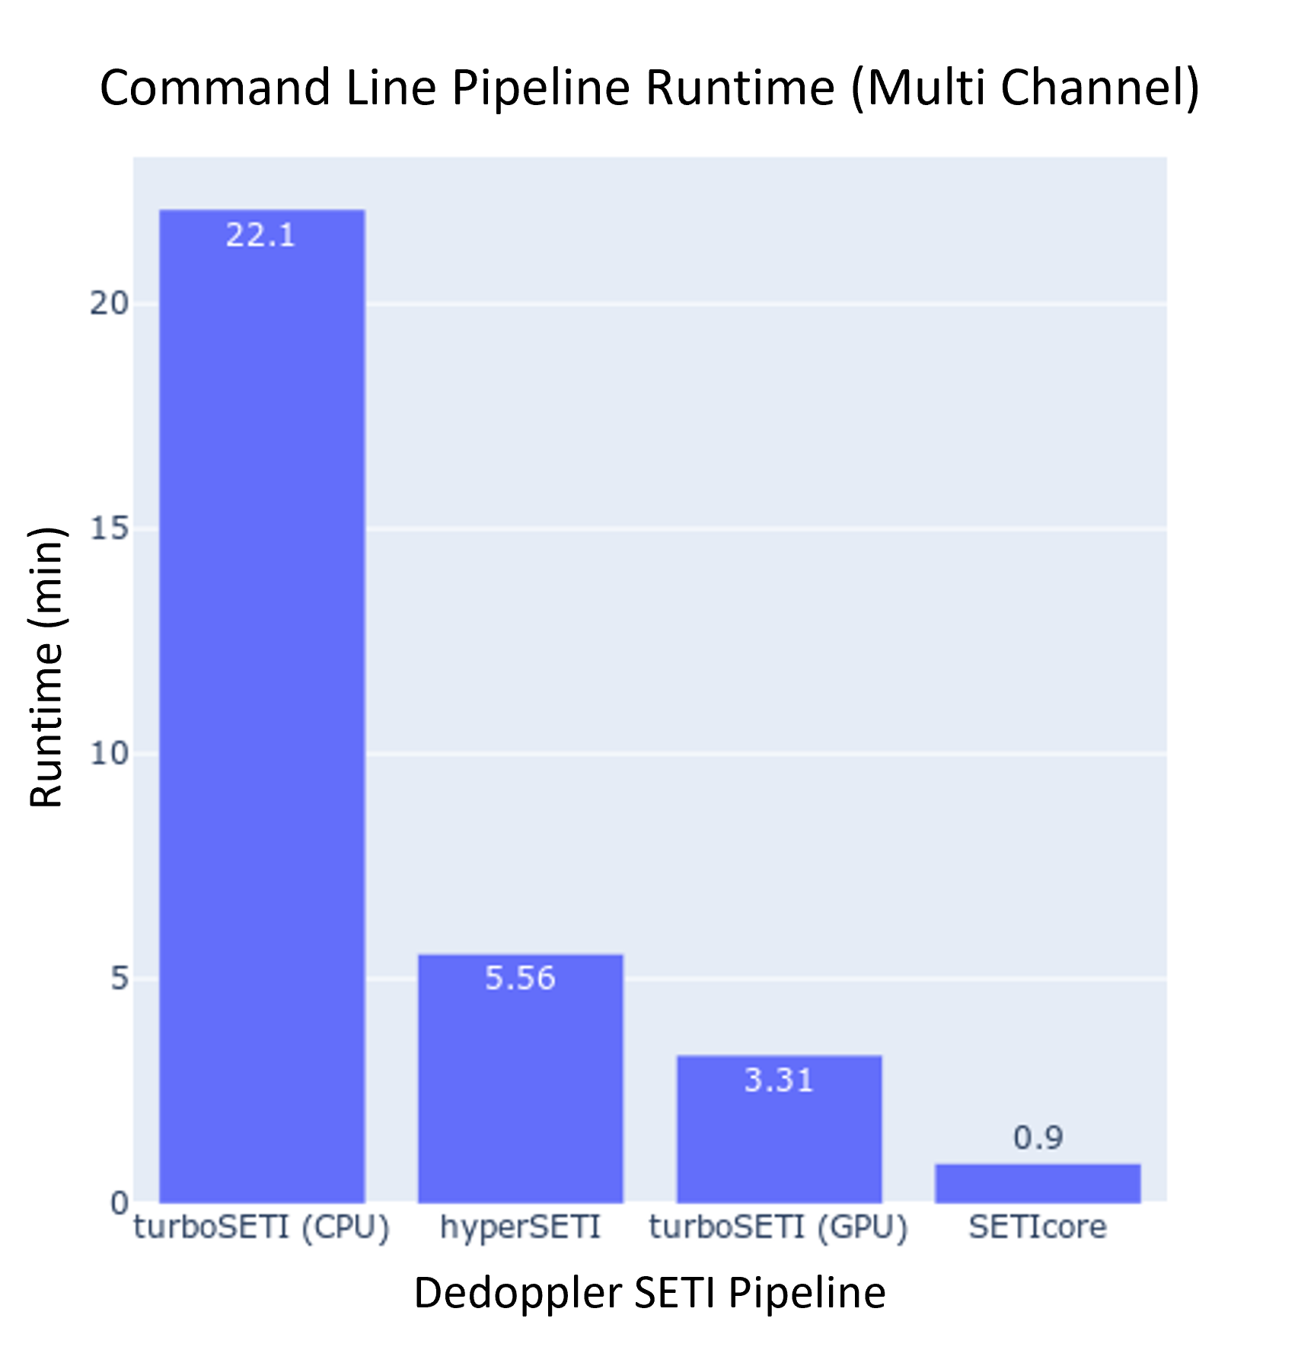
Week 5: Wrapping up Performance & I/O Comparisons
Dedoppler Pipelines
hyperSETI use issues resolved
Test data added
Comparison of single and multi coarse channel input .h5 files
Relative runtime performance compared for small/simple file vs more realistic full size multi-channel file
Single channel hyperSETI marginally outperforms turboSETI (GPU)
Multi-channel turboSETI (GPU) outperforms hyperSETI
SETIcore is clearly highest performing across all input data
All performance data obtained on blpc1 node using TITAN Xp GPU for maximum consistency
I/O confirmed to be functionally equivalent (though not identical)

Slide 8
Week 5: Further Analysis of Dedoppler Pipelines: Algorithms & User Experience
turboSETI
Algorithm
Dedoppler – Taylor Tree
Higher theoretical performance than Brute-Force
Hit-search – 2-step Iterate through Frequency
Step 1 – Iterate through each given spectral resolution [freq_start-freq_end] and record hits above SNR threshold
Step 2 – Iterate through hits, and finds larges SNR between neighbor frequency channels
User Experience
Command line util
Easy with plenty of flag options
Python Package
Straightforward but less easily modular
I/O, dedoppler algorithm, and hit-search all called from main FindDoppler class
Documentation and Codebase
Sufficient documentation for whole pipeline, lacking info for base function code blocks
Python codebase – easily digestible
Install
Many dependencies but should be easy enough to create virtual environment
Not tested as BL servers have all needed packages & working install
hyperSETI
Algorithm
Dedoppler – Brute-Force
Lowest theoretical performance
Hit-search – 2-step Maxima Based
Step 1 – Maxima finding with cupy (GPU)
Step 2 – Iterate through beam index (frequency band) and find hits identified in step 1
User Experience
Command line util
Requires Conda virtual environment
Python Package
Modular and as straightforward as turboSETI
Dedoppler, Hit-search, etc independently callable functions
Allows insight into each algorithm
Documentation and Codebase
Severely lacking documentation
Brief README but not much else
Python codebase – easily digestible at least!
Install
Fewer dependencies than turboSETI
Requires virtual environment
Not tested as BL servers have this virtual conda environment setup
SETIcore
Algorithm
Dedoppler – Taylor Tree
Higher theoretical performance than Brute-Force
Hit-search – 2-step Iterative
Step 1 – Break dedoppler run into frequency “windows”
Step 2 – Iterate through “windows” for maximum
User Experience
Command line util
Easy with plenty of flag options
Self-contained program
C++/CUDA so compiled program
Documentation and Codebase
Lacking documentation
Mostly for install
Not much available for further useage
C++ and CUDA codebase – much more obfuscated and difficult to interpret
Install
Many header and C++ files but all self-contained in repo
New program compilation not tested and working install on BL servers

Slide 9
Week 5: Comprehensive Survey & Benchmarking Writeup
Full consolidated reference to all testing and analyses performed
Benchmarking / performance
Input / output comparisons
Algorithm analysis
User experience / interfacing
Writeup includes data, links, full analysis, and recommendations for future development
Will all be available online!
All testing work and files (except .h5/.fil files) live on GitHub
Final writeup version will be soon pushed to GitHub

Slide 10
Week 6: Mid-way Project Definition
What are we trying to do?
Provide higher performance tools to accelerate radio SETI
Create software tools to search for and identify interesting narrowband signals
What has already been done?
Algorithm research & optimization for similar mathematical problem
Dedispersion – quadratic curve searching
Dedoppler – linear curve searching
Implementation by various researchers & groups
Standalone dedispersion algorithms (general transient astronomy relevance)
Dedoppler pipeleines (SETI specific relevance)
How can we improve?
Move from CPU to GPU
Readily parallelizable algorithms
Move to higher performance computer languages
Python is easy to understand but slow
Julia offers ease of coding with low-level performance gains
Why?
Dedoppler drift search is an important SETI methodology, and tools could use updating
Anyone used turboSETI before?
Imagine at least 10x redux in runtime!
Decreased runtime == increased throughput
Gives scientists more time to gather data not just process it

Slide 11
Week 6: Project Accomplishments & Status
Problem research & definition
Reading of research articles
Dedispersion vs dedoppler
Existing solution evaluation
Benchmarking / performance
Implementation analysis
Report / conclusions

Slide 12
Week 6: Project Advancement & Scoping
Solution definition & planning
Dedoppler SETI pipeline deconstruction
Work breakdown by code block for further development and implementation
Max
Kevin
File Input / Data Preprocessing
Dedoppler Algorithm (Brute-Force, Taylor-Tree, etc.)
Hit-Search (Iterative, Maxima finding, etc.)
Hit File Output & Plotting
.h5
End process
0.0109s | 0.18%
3.4169s | 56.14%
2.5147s | 41.32%
0.1441s | 2.36%
*Runtimes based on deconstructed hyperSETI pipeline script

Slide 13


Week 7: Julia and GPU-Accelerated Radio SETI Lightning Talk with Green Bank
What are we trying to do?
Provide higher performance tools to accelerate radio SETI
What has already been done?
Algorithm research & optimization for similar mathematical problem
Implementation by various researchers & groups
How can we improve?
Move from CPU to GPU
Move to higher performance computer languages
Why?
Dedoppler drift search is an important SETI methodology, and tools could use updating
Decreased runtime == increased throughput
Max
Kevin
.h5
File Input / Data Preprocessing
Dedoppler Algorithm (Brute-Force, Taylor-Tree, etc.)
Hit-Search (Iterative, Maxima finding, etc.)
Hit File Output & Plotting
End process
0.0109s | 0.18%
3.4169s | 56.14%
2.5147s | 41.32%
0.1441s | 2.36%
*Runtimes based on deconstructed hyperSETI pipeline script

Slide 14
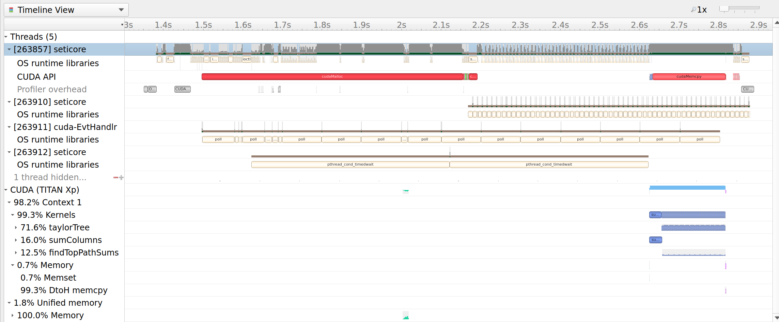
Week 8: Further Exploration of Hit-Search Algorithm
Max
Kevin
.h5
File Input / Data Preprocessing
Dedoppler Algorithm (Brute-Force, Taylor-Tree, etc.)
Hit-Search (Iterative, Maxima finding, etc.)
Hit File Output & Plotting
End process
Dedoppler and Hit-search algorithms need most development
Max = Dedoppler
Kevin = Hit-search
NVIDIA Nsight Systems profiling
0.0109s | 0.18%
3.4169s | 56.14%
2.5147s | 41.32%
0.1441s | 2.36%
*Runtimes based on deconstructed hyperSETI pipeline script

Slide 15
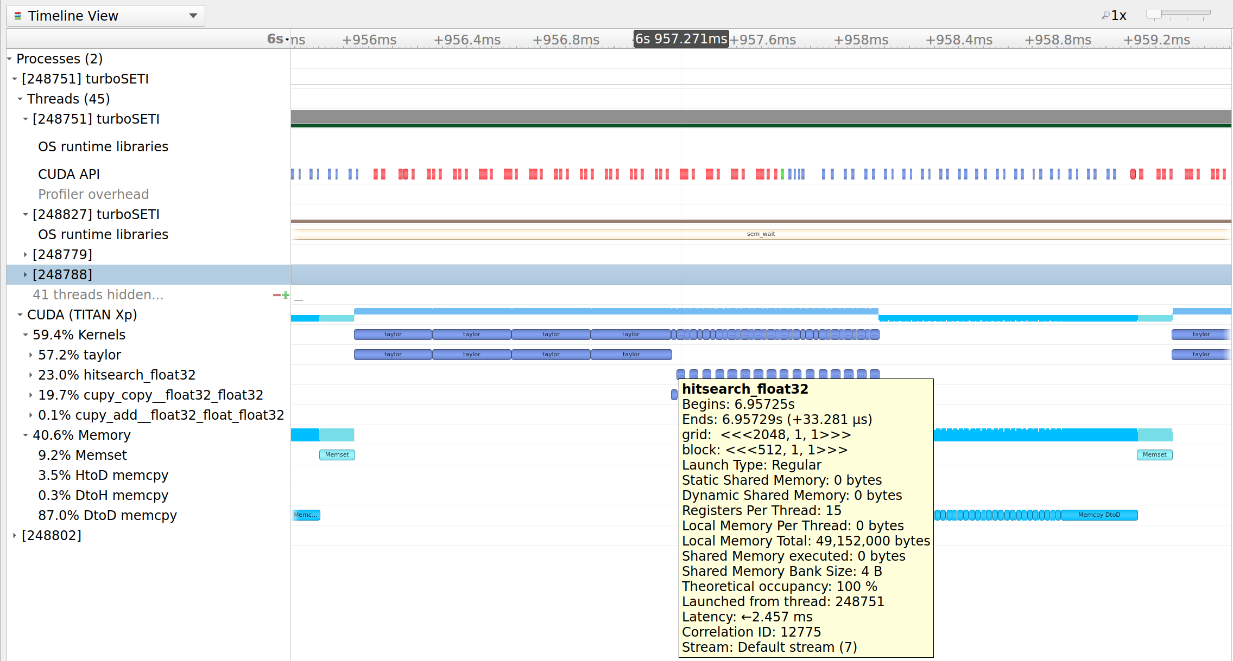
Week 8: Nsight Systems Comparison: turboSETI
Pros:
Asynchronous memory transfer from GPU back to host
Cons:
Questionable DtoD memory shuffle (87%)
Huge 94.48% CPU overhead (not seen here)

Slide 16
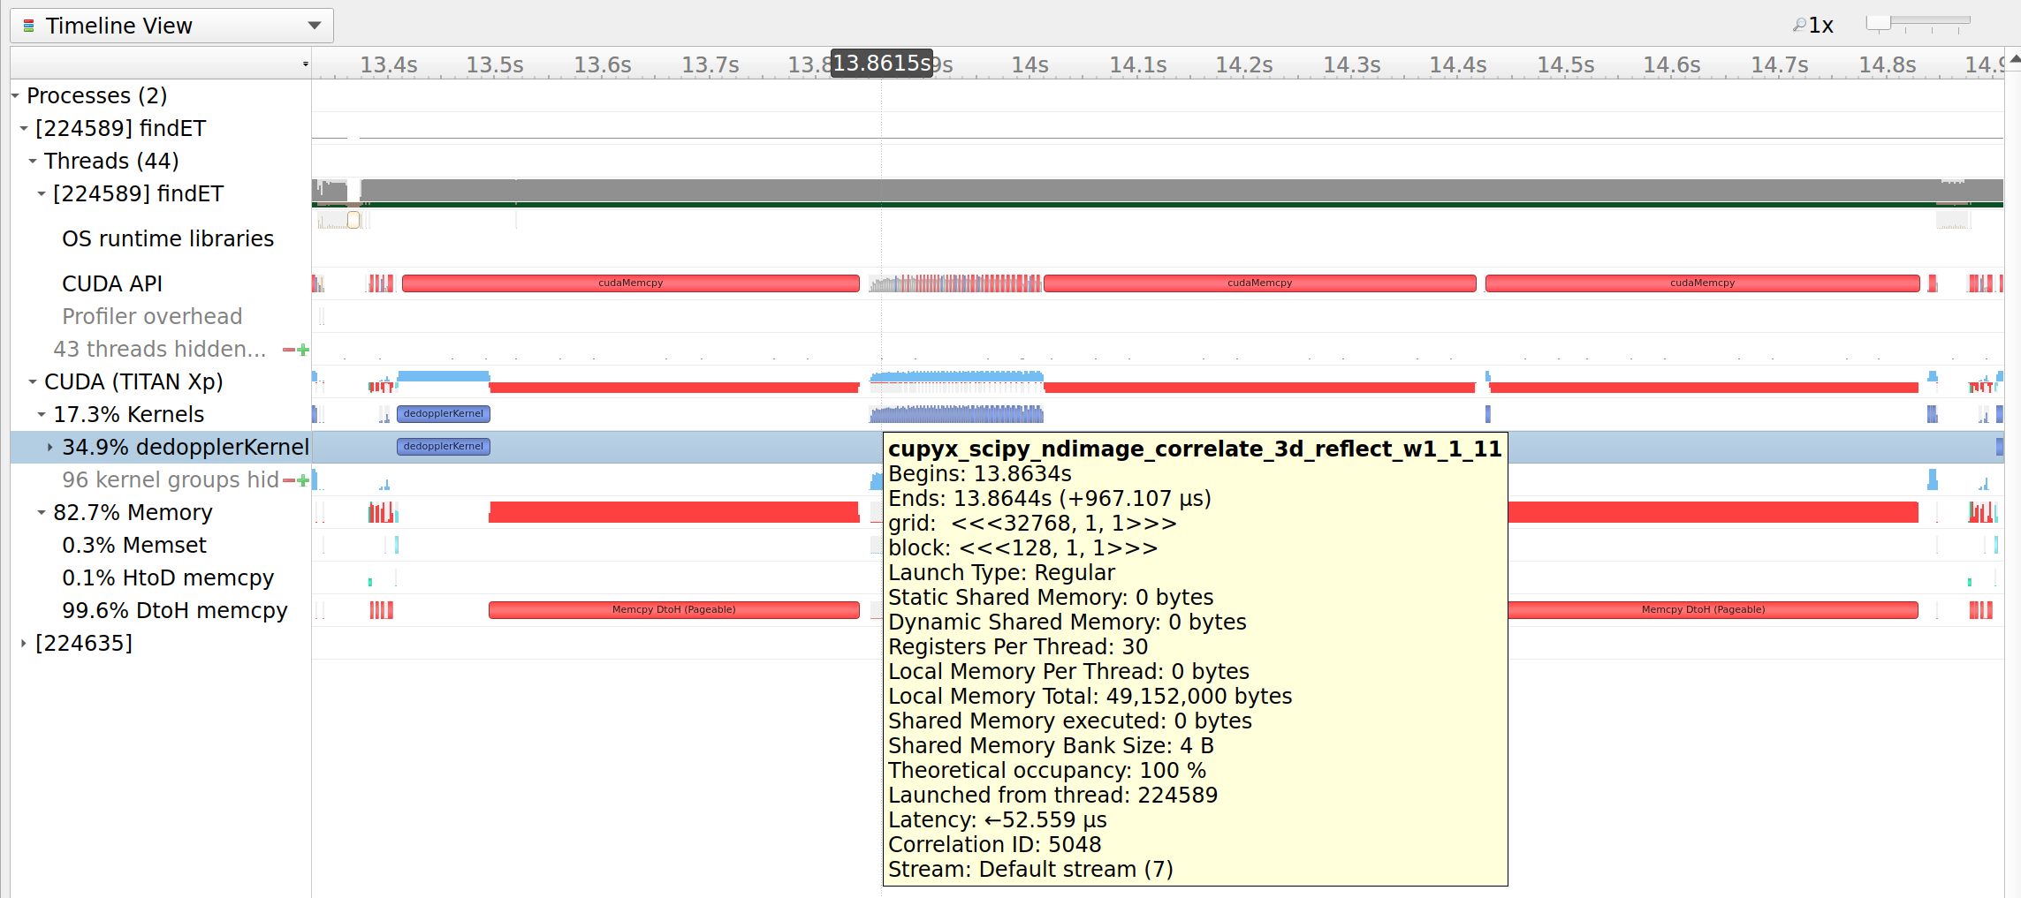
Week 8: Nsight Systems Comparison: hyperSETI
Pros:
Greater GPU usage (37.16% total runtime)
Cons:
Poor memory management due to modularity
Higher runtime of hit-search than Brute-Force dedoppler when theoretically lower algorithmic complexity

Slide 17
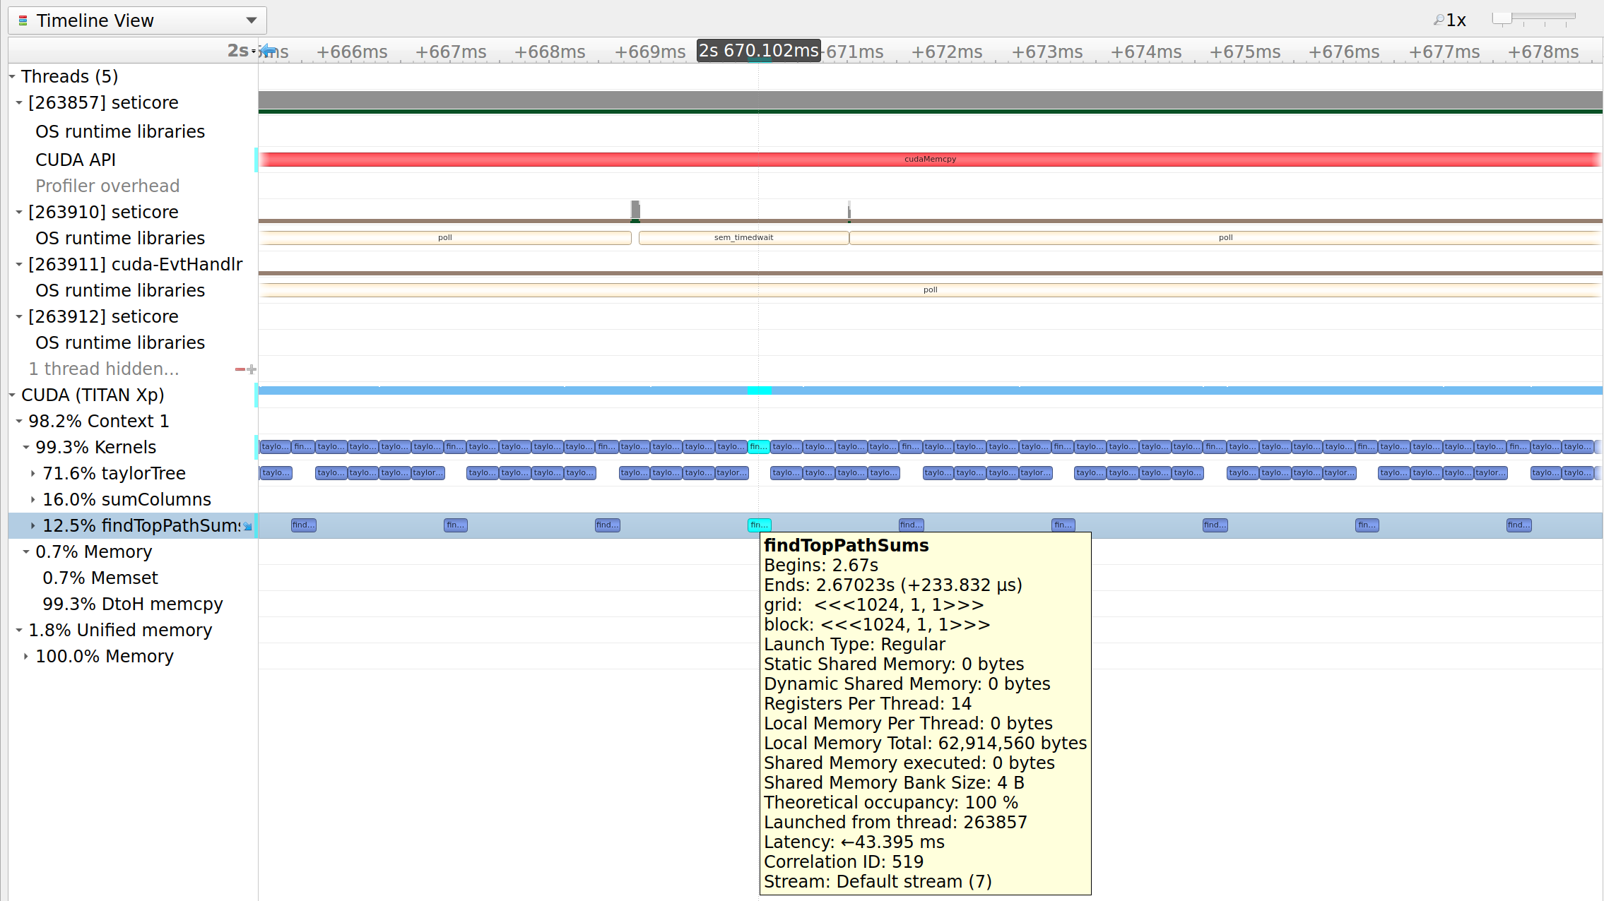
Week 8: Nsight Systems Comparison: SETIcore
Pros:
Good memory management
Asnych DtoH
Unified memory
Only 1.87% GPU execution time
True to theory execution time between Taylor-Tree dedoppler and iterative hit-search algorithms
Cons:
Still looking!

Slide 18
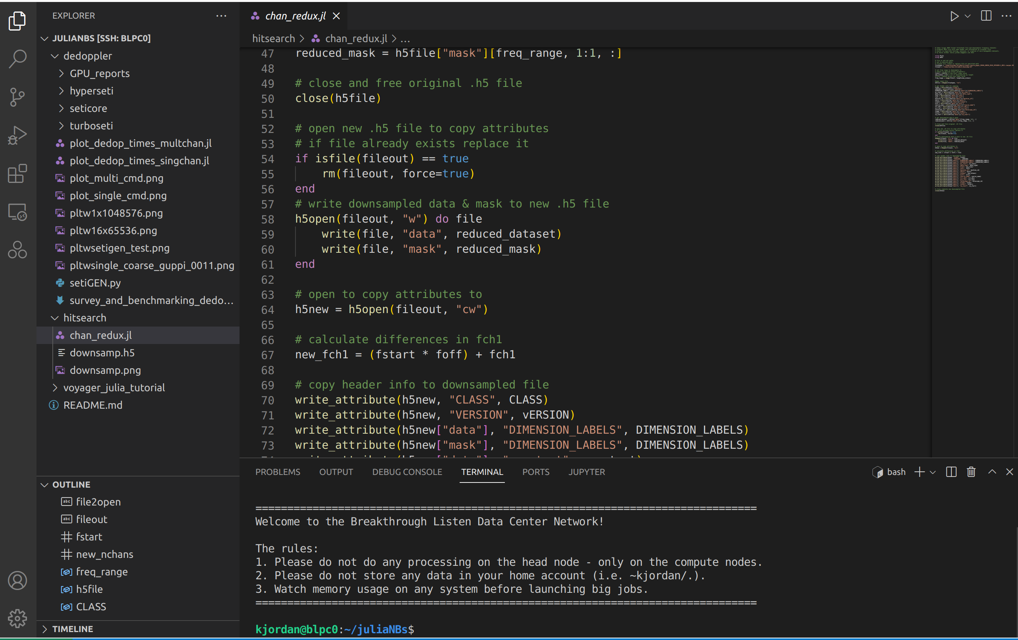
Week 8: HDF5 Filterbank Downsampler
Test file needed!
Wanted smaller number of freq channel .h5 format file & maintain filterbank header data
Useful for testing hit-search algorithm block
Always good to have more Julia practice
Decided others might need this too!
*bitshuffle plugin quirks*

Slide 19
Week 8: Future Developments
Tinkering with Hit-search in Julia
Done?
Problem spots isolated
Thorough review of each section’s benefits
Simplified testing / debugging file generated
To Do?
Get both steps up and running
First step: Initial iterations to find all over SNR
Second step: Elimination of duplicate reports between neighboring windows
Optimize GPU processes
Integrate with output step of Max’s dedoppler algorithm
What would be nice if time?
Input .h5 handling (semi-solved with HDF5 downsampler script)
Output .dat report generation

Slide 20
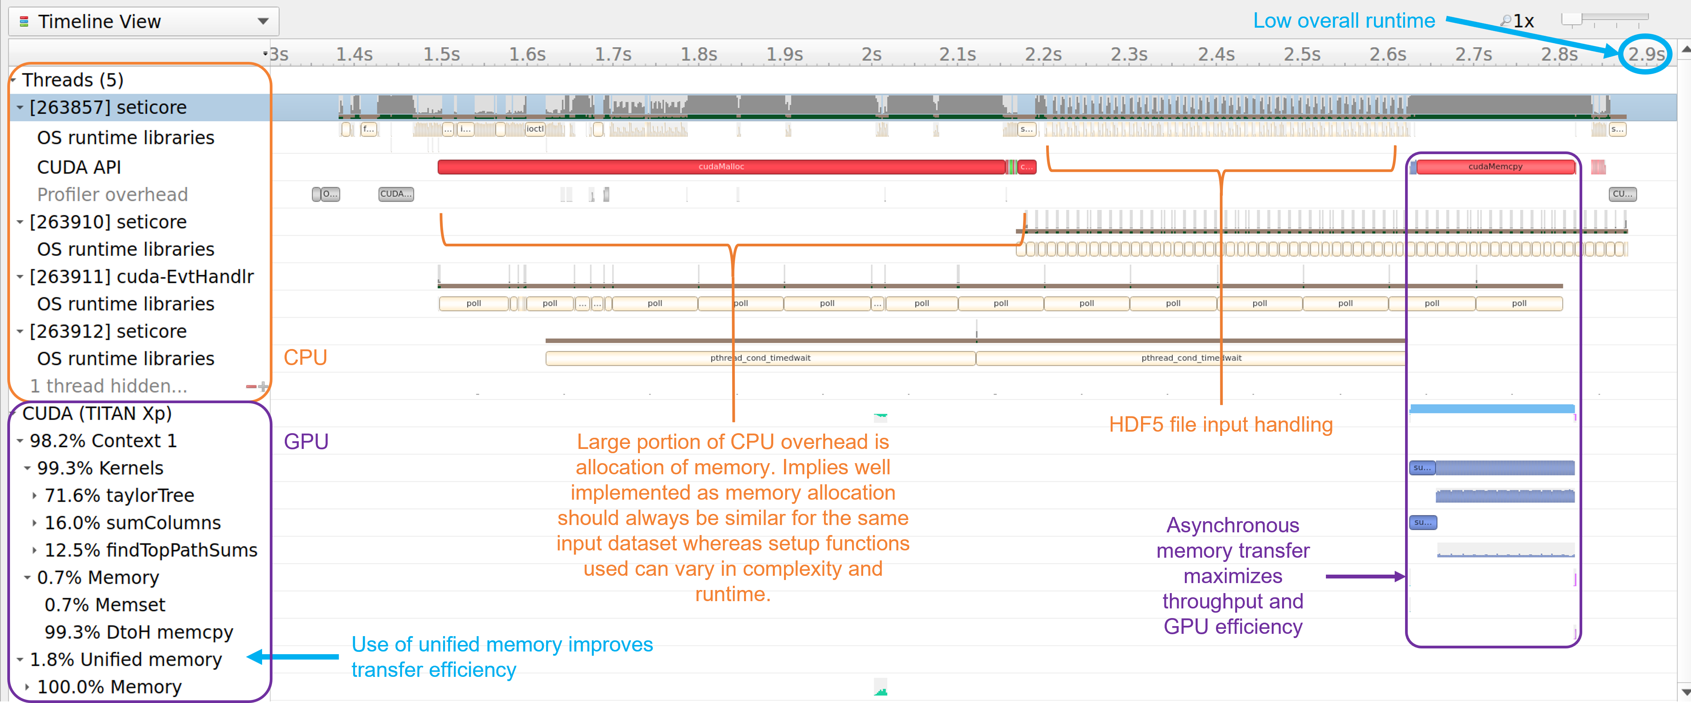
Week 9: Nsight System Reports Markup
Took initial Nsight Systems screenshots and annotated them
Provides a standalone product for easy sharing and understanding

Slide 21
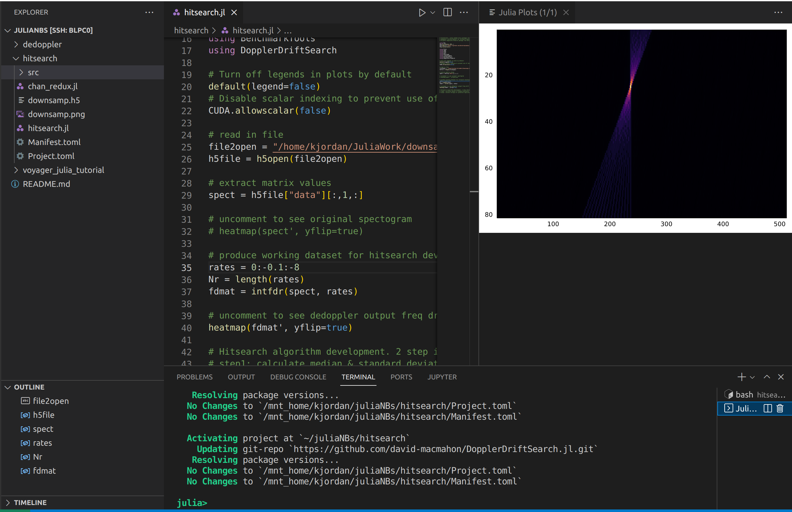
Week 9: Hit-Search
Let’s get tinkering!
Setup a script to generate data matrix similar to output from the dedoppler algorithm
More code review
SETIcore deciphering
Julia function/package optimization research
Trial / error
Runtime profiling

Slide 22
Week 9: Future Developments
Continued Development of Hit-search using Julia
Done?
Initial pipeline setup script to provide needed input dataset for hit-search
Research on best methods to implement 1st iterative hit-search step
To Do?
Complete development of hit-search (2nd step)
Optimize GPU processes
Integrate with output step of Max’s dedoppler algorithm
What would be nice if time?
Input .h5 handling (semi-solved with HDF5 downsampler script)
Output .dat report generation

Slide 23
Week 10: Final Presentation
See following slides…

Slide 24
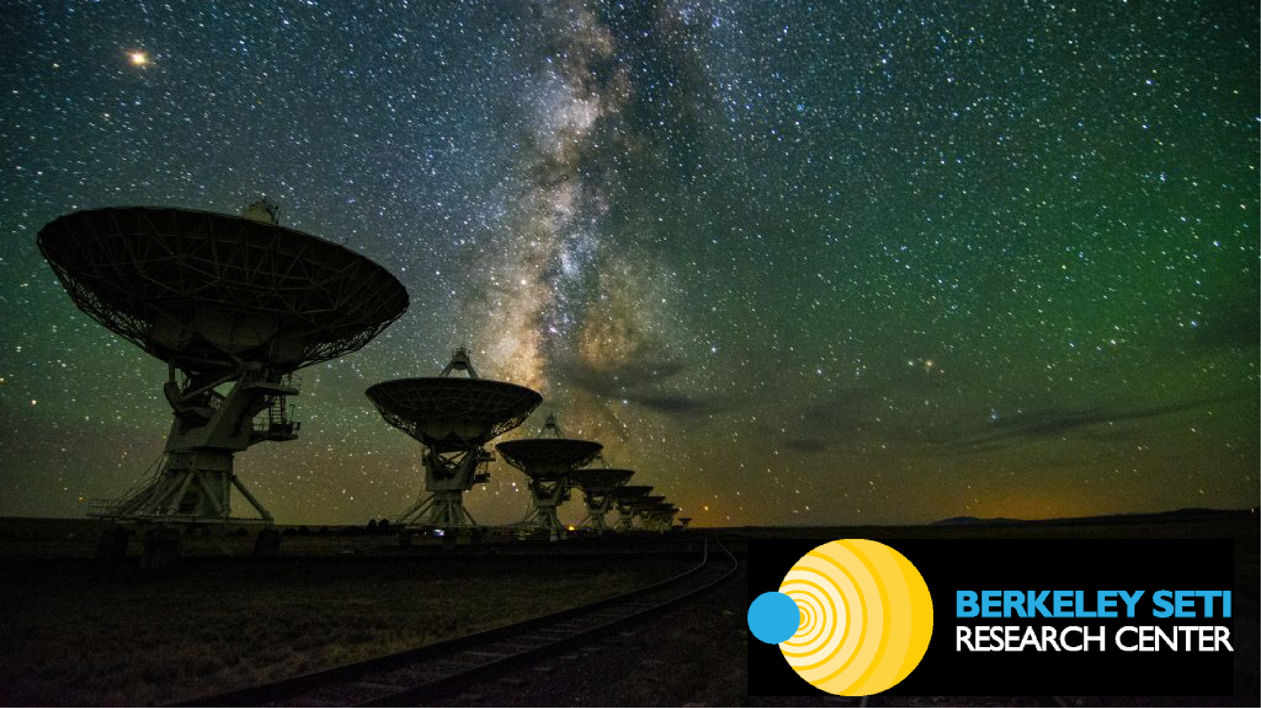
Julia and GPU-Accelerated Radio SETI
Kevin Jordan & Max Hawkins
With Support of Mentors David MacMahon & Daniel Czech
12 AUG 2022

Slide 25
Project Background
What are we trying to do?
Provide higher performance tools to accelerate radio SETI
What has already been done?
Algorithm research & optimization for similar mathematical problem
Implementation by various researchers & groups
How can we improve?
Move from CPU to GPU
Move to higher performance computer languages
Why?
Dedoppler drift search is an important SETI methodology, and tools could use updating
Decreased runtime == increased throughput

Slide 26
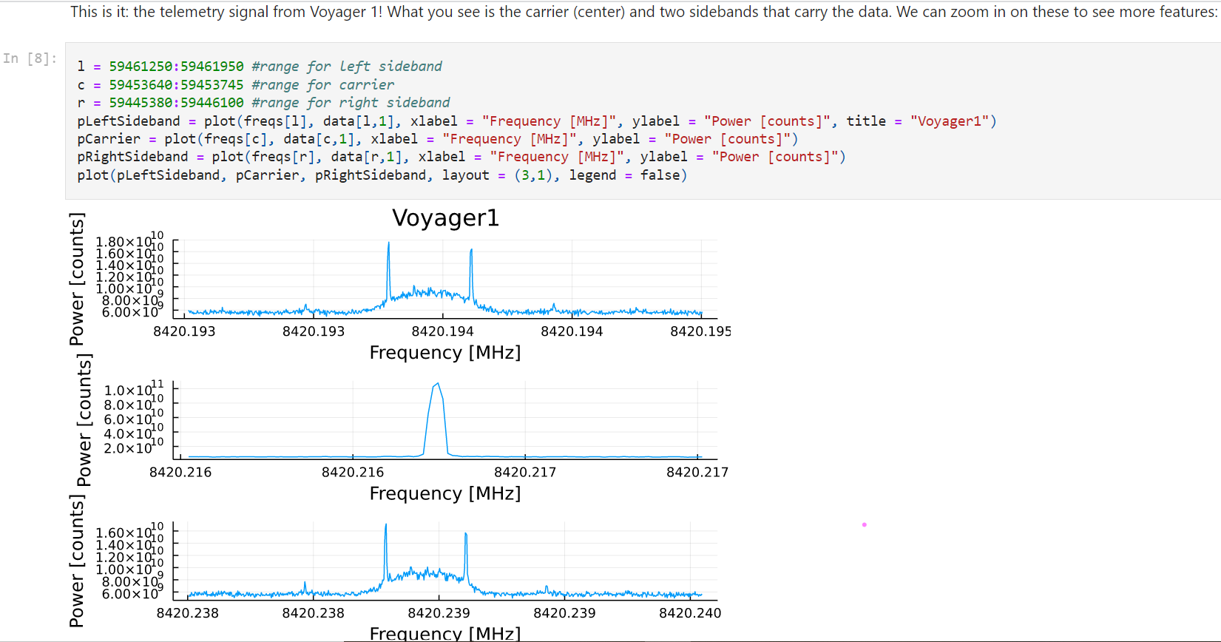
Phase I: Research & Training
Problem research & definition
Reading of research articles
Dedispersion vs dedoppler
Julia Programming
Reading of documentation
Voyager Julia Notebook!

Slide 27
Phase II: Benchmarking
Max = Dedispersion
Kevin = Dedoppler
3 Pipelines Tested
turboSETI (CPU & GPU)
hyperSETI (D. Price)
SETIcore (K. Lacker)
Ran as End User
Used command line interface
Entire pipeline runtime including I/O, dedoppler, & hit-search recorded
Multiple input dataset sizes used

Slide 28
Phase III: Individual Algorithm Development
Dedoppler and Hit-search algorithms need most development
Max = Dedoppler
Kevin = Hit-search
NVIDIA Nsight Systems profiling
Max
Kevin
.h5
File Input / Data Preprocessing
Dedoppler Algorithm (Brute-Force, Taylor-Tree, etc.)
Hit-Search (Iterative, Maxima finding, etc.)
Hit File Output & Plotting
End process
0.0109s | 0.18%
3.4169s | 56.14%
2.5147s | 41.32%
0.1441s | 2.36%
*Runtimes based on deconstructed hyperSETI pipeline script

Slide 29
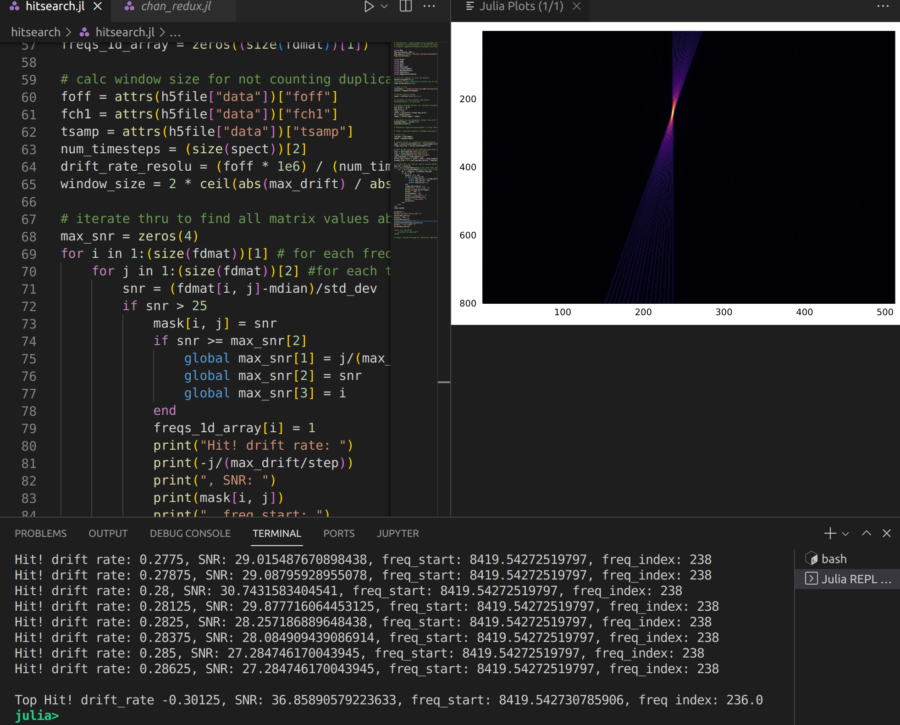
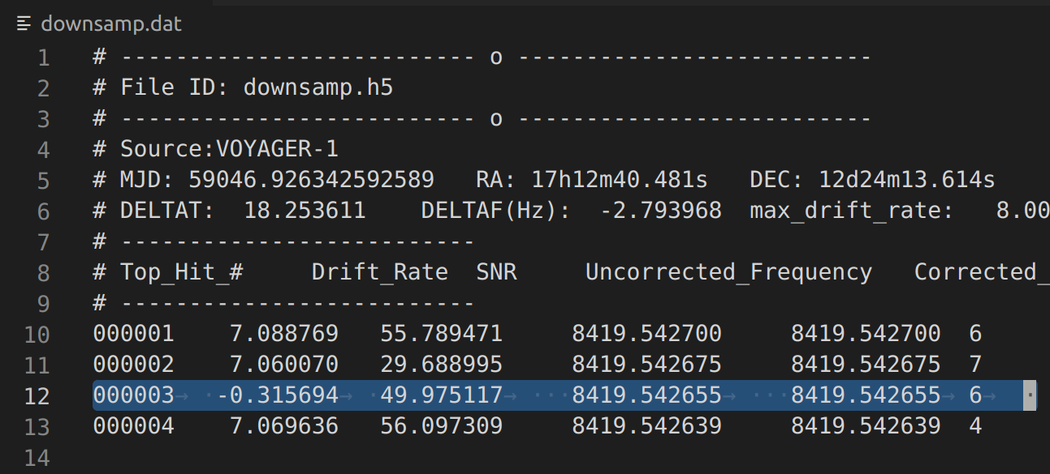
Realizations & Results
Julia Hit-Search algorithm (mostly working!)
Detailed whitepaper holistically evaluating usage of turboSETI, hyperSETI, & SETIcore
HDF5 downsampling script in Julia
Voyager BL Demo Jupyter Notebook in Julia
turboSETI
My Julia Hit-Search

Slide 30
Future Development & Recommendations
Hit-search Julia Implementation
Finish integrating both hit-search & top-hit-search parts for full datasets
Parallelize and optimize on GPU
Integration of FastDeDopplerTransform (FDDT) & Hit-Search
Join output of Max’s new FDDT algorithm to input of new Julia hit-search
Configure parameters for both algorithm blocks
Addition of HDF5 file input and .dat report generation
Complete equivalent/replacement Julia implemented dedoppler pipeline
Compare and benchmark against existing pipelines
Get science team feedback and use testing
Optimize algorithms as necessary

Slide 31
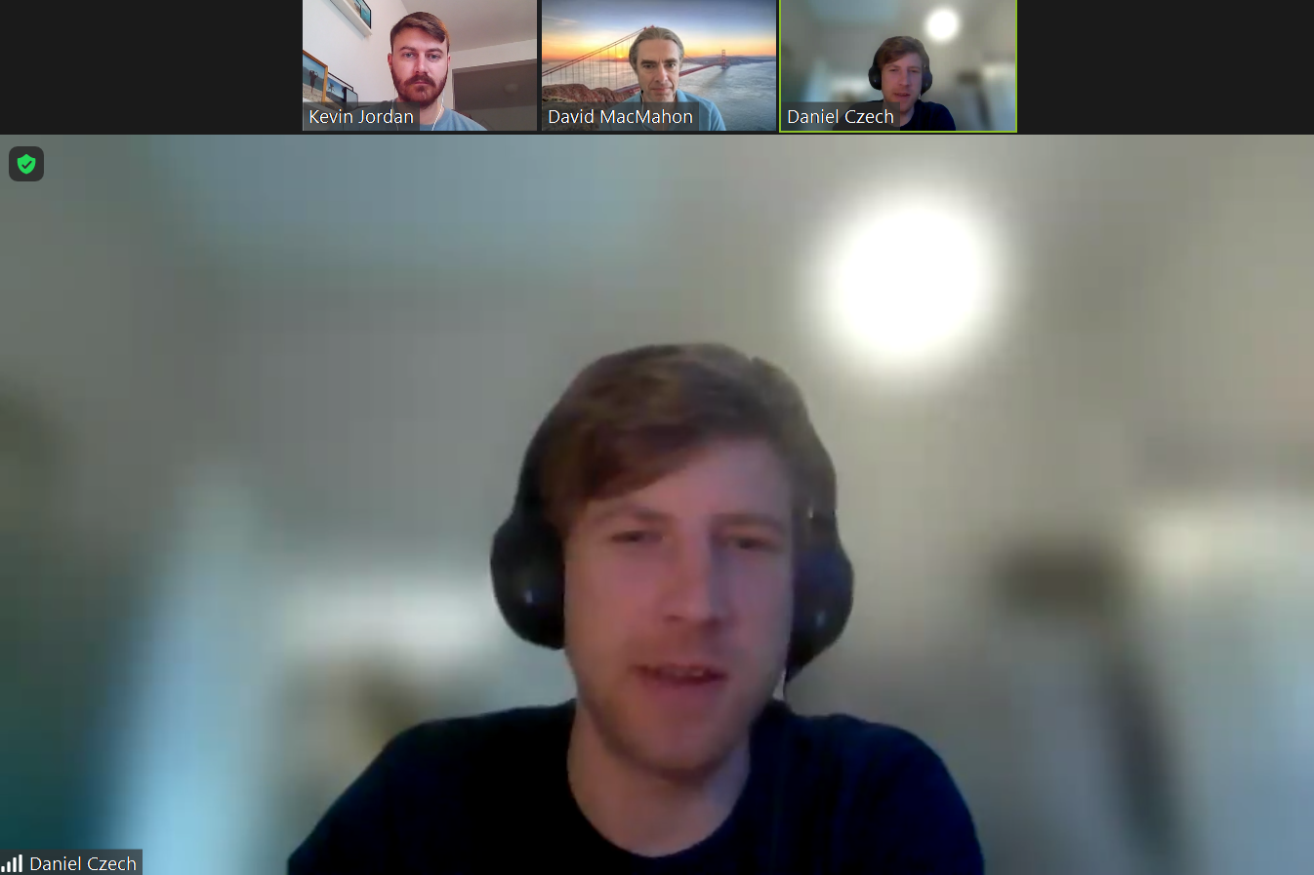
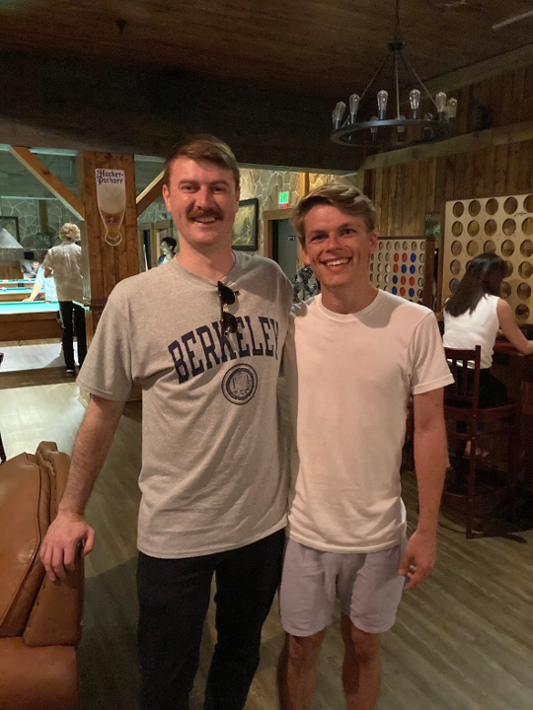
A Huge Thank You!
Special thanks to David MacMahon & Daniel Czech
for guidance, wisdom, and support!
Max Hawkins for awesome collaboration and talks!
Steve Croft, Andrew Siemion, Kevin Lacker, Richard Elkins,
and the rest of the Breakthrough Listen & Berkeley SETI Research Center crew!
It has been an absolute pleasure getting to know and work with you all, as well as
my fellow interns!

Slide 32
Questions
???

